Slide 1


Tableau Mini-Project
Due 26/07/2021
Boutique sales products Analysis

Slide 2
This project is presented by :
VALCIN Pierry
Finance| Data Analyst

Slide 3
Table of content
01
Introduction
02
Problem
03
Methodology
04
Results
05
Discussions & Proposed solutions
06
References & Appendices

Slide 4
Introduction
This project is written as part of a tableau data processing , in which we was asked to draw out insights as a Data Analyst for a Bank on their Credit transactions for 2020.

Slide 5

Problem
What is the business problem?
The bank wants to limit the risk of loss on delinquent loans and make more profit to increase its loan portfolio

Slide 6
Problem
Who are the stakeholders impacted by the problems?
The stakeholders affected by this problems are :
The Executive boards of the Bank that want to increase their credit portofolio and make more profit on the money avalaible for credit.
The Customers : the bank's customers want to have access to credit for their consumption and investment needs.

Slide 7
Problem
Why is this problem important to the organization?
Credit risk refers to the probability of loss due to a borrower’s failure to make repayments of any type of credit, and credit risk management is the practice of mitigating the probability of loan loss due to borrower’s failure to make loan payments at any given time. Limited risk is essential for the bank.

Slide 8
Methodology
To realized this project, we used:
A credit Dataset provided by the Bank
The main tool we used for the data processing is Tableau Software. We used it to do the merging of the dataset, data cleaning and also data visualization.
Our approach is Diagnostic Analysis to provide a more in-depth analysis. We highlight profit/loss made by the banks, the age distribution of the customers and why they take a loan.

Slide 9
Risk Management
Managing credit risks is one of the main focus of any banking operations these days as fraudsters and unethical customers have sophisticated methods to deceive the banks.
Because of this, the effective management of credit risk has become a critical component and the banks need to monitor, control, and measure its credit risk practices more often to ensure their long term success.

Slide 10
Insights regarding the dataset
The Banks lost 64 355 600 $ in Charged-off loans.
Grade D loan represent 29,15 % of charged of loan
43.75 % of the charged-off customers has between 25-40 years old
Clients living in rented accommodation represent 73.15 % of Charged-off loans.

Slide 11
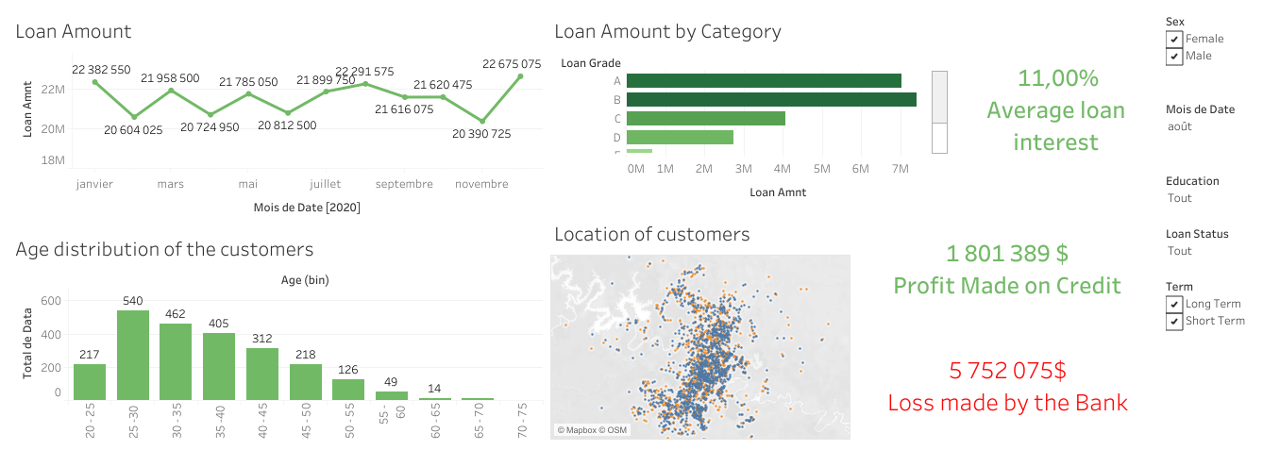
Dashboard Made using Tableau

Slide 12
Discussion & Proposed Solution
Based on the insights provided by the data processing we did , we can come up with several proposals to help the banks lower the risk.
Thoroughly check a new customer’s credit record
Establish credit limits specially on people in rent accomodation and in the age varialbe of 25 – 40 years old
Start the debt recover in the first 90 days after the Due Date

Slide 13
References & Appendices
https://searchcompliance.techtarget.com/definition/risk-management#:~:text=Risk%20management%20is%20the%20process,errors%2C%20accidents%20and%20natural%20disasters
https://www.tutorialspoint.com/tableau/index.htm

Slide 14
THANKS
Contact Us
I you have any question about this presentation, Feel free to send us a message in the #help-python channel on slack.
Ressources
See the full project
Tableau Public Link

